Slide 1
Principles of Information Systems, Thirteenth Edition
Chapter 1
An Introduction to Information Systems
Notes:
Principles of Information Systems, Thirteenth Edition
Chapter 1
An Introduction to Information Systems

Slide 2
Objectives
After completing this chapter, you will be able to:
Distinguish data from information and knowledge, and describe the characteristics of quality data
Identify the fundamental components of an information system and describe their function
Identify the three fundamental information system types and explain what organizational complements must be in place to ensure successful implementation and use of the system
Notes:
Objectives
After completing this chapter, you will be able to:
Distinguish data from information and knowledge, and describe the characteristics of quality data
Identify the fundamental components of an information system and describe their function
Identify the three fundamental information system types and explain what organizational complements must be in place to ensure successful implementation and use of the system

Slide 3
Objectives
After completing this chapter, you will be able to (cont’d):
Identify and briefly describe the role of each component of an organization’s technology infrastructure
Identify the basic types of business information systems, including who uses them, how they are used, and what kinds of benefits they deliver
Describe how organizations are using business intelligence and business analytics to capitalize on the vast amount of data becoming available
Notes:
Objectives
After completing this chapter, you will be able to (cont’d):
Identify and briefly describe the role of each component of an organization’s technology infrastructure
Identify the basic types of business information systems, including who uses them, how they are used, and what kinds of benefits they deliver
Describe how organizations are using business intelligence and business analytics to capitalize on the vast amount of data becoming available

Slide 4
Objectives
After completing this chapter, you will be able to (cont’d):
Discuss why it is critical for business objectives and IS activities to be well aligned through system planning, development, and acquisition
Identify several major IT security threats as well as some of the legal, social, and ethical issues associated with information systems
Notes:
Objectives
After completing this chapter, you will be able to (cont’d):
Discuss why it is critical for business objectives and IS activities to be well aligned through system planning, development, and acquisition
Identify several major IT security threats as well as some of the legal, social, and ethical issues associated with information systems

Slide 5
An Introduction to Information Systems
Information
One of an organization’s most valuable resources
Often confused with the term data
Notes:
An Introduction to Information Systems
Information
One of an organization’s most valuable resources
Often confused with the term data

Slide 6
Data, Information, and Knowledge
Data: raw facts
Information: collection of data organized in such a way that they have value beyond the facts themselves
Process: set of logically related tasks performed to achieve a defined outcome
Turning data into information is a process
Knowledge: awareness and understanding of a set of information and the ways it can be made useful to support a task
The process of defining relationships among data to create useful information requires knowledge
Notes:
Data, Information, and Knowledge
Data: raw facts
Information: collection of data organized in such a way that they have value beyond the facts themselves
Process: set of logically related tasks performed to achieve a defined outcome
Turning data into information is a process
Knowledge: awareness and understanding of a set of information and the ways it can be made useful to support a task
The process of defining relationships among data to create useful information requires knowledge

Slide 7
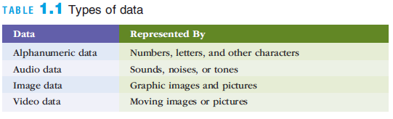
Data, Information, and Knowledge
Notes:
Data, Information, and Knowledge

Slide 8
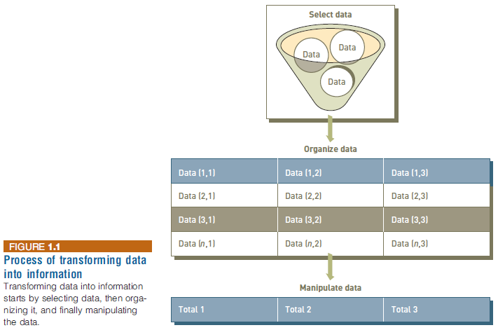
Data, Information, and Knowledge
Notes:
Data, Information, and Knowledge

Slide 9
The Value of Information
Valuable information helps people perform tasks more efficiently and effectively
Inaccurate data can result in loss of potential new customers and reduced customer satisfaction
Notes:
The Value of Information
Valuable information helps people perform tasks more efficiently and effectively
Inaccurate data can result in loss of potential new customers and reduced customer satisfaction

Slide 10
Characteristics of Quality Information
If an organization’s information is not accurate or complete:
People can make poor decisions, costing thousands, or even millions, of dollars
Depending on the type of data you need:
Some characteristics become more important than others
Accuracy and completeness are critical for data used in accounting for the management of company assets
Notes:
Characteristics of Quality Information
If an organization’s information is not accurate or complete:
People can make poor decisions, costing thousands, or even millions, of dollars
Depending on the type of data you need:
Some characteristics become more important than others
Accuracy and completeness are critical for data used in accounting for the management of company assets

Slide 11
What is an Information System?
An information system (IS) is a set of interrelated elements that:
Collect (input)
Process
Store
Disseminate data and information
Provides a feedback mechanism to monitor and control its operation to make sure it continues to meet its goals and objectives
A computer-based information system (CBIS) is a single set of hardware, software, databases, networks, people, and procedures
That are configured to collect, manipulate, store, and process data into information
An organization’s technology infrastructure includes all the hardware, software, databases, networks, people, and procedures
That are configured to collect, manipulate, store, and process data into information
Notes:
What is an Information System?
An information system (IS) is a set of interrelated elements that:
Collect (input)
Process
Store
Disseminate data and information
Provides a feedback mechanism to monitor and control its operation to make sure it continues to meet its goals and objectives
A computer-based information system (CBIS) is a single set of hardware, software, databases, networks, people, and procedures
That are configured to collect, manipulate, store, and process data into information
An organization’s technology infrastructure includes all the hardware, software, databases, networks, people, and procedures
That are configured to collect, manipulate, store, and process data into information

Slide 12
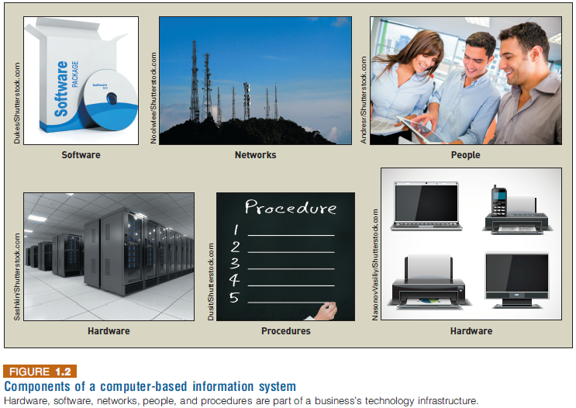
What is an Information System?
Notes:
What is an Information System?

Slide 13
What is an Information System?
Procedure defines the steps to follow to achieve a specific end result
Such as enter a customer order, pay a supplier invoice, or request a current inventory report
Using a CBIS involves setting and following many procedures, including those for the
Operation, maintenance, and security of the system
Notes:
What is an Information System?
Procedure defines the steps to follow to achieve a specific end result
Such as enter a customer order, pay a supplier invoice, or request a current inventory report
Using a CBIS involves setting and following many procedures, including those for the
Operation, maintenance, and security of the system

Slide 14
Information Systems in Organizations
Information systems can be divided into three types:
Personal IS – includes information systems that improve the productivity of individual users
Group IS –includes information systems that improve communications and support collaboration among members of a workgroup
Enterprise IS – includes information systems that organizations use to define structured interactions among their own employees and/or external customers, suppliers, government agencies, etc…
Notes:
Information Systems in Organizations
Information systems can be divided into three types:
Personal IS – includes information systems that improve the productivity of individual users
Group IS –includes information systems that improve communications and support collaboration among members of a workgroup
Enterprise IS – includes information systems that organizations use to define structured interactions among their own employees and/or external customers, suppliers, government agencies, etc…

Slide 15
Information Systems in Organizations
For each type of IS, certain key organizational complements must be in place:
Well-trained workers
System support
Better teamwork
Redesigned processes
New decision rights
Notes:
Information Systems in Organizations
For each type of IS, certain key organizational complements must be in place:
Well-trained workers
System support
Better teamwork
Redesigned processes
New decision rights

Slide 16
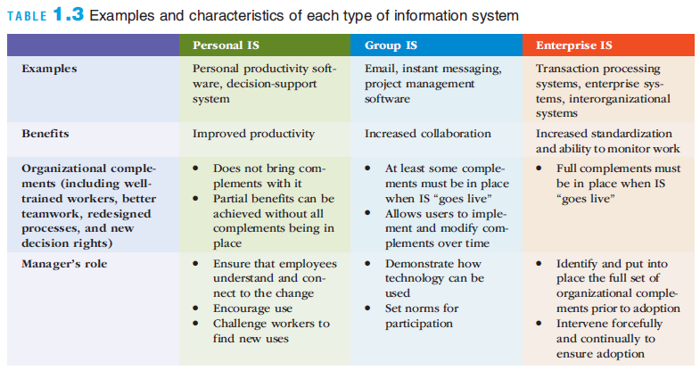
Information Systems in Organizations
Notes:
Information Systems in Organizations

Slide 17
Hardware and Mobile Devices
Hardware
Consists of computer equipment used to perform input, processing, storage, and output activities
A trend in the industry is to produce smaller, faster, and more mobile hardware
Innovative new hardware devices include:
Advanced keyboards
Laptops and displays that connect wirelessly
Embedded 3D cameras
Very-high resolution display devices
Notes:
Hardware and Mobile Devices
Hardware
Consists of computer equipment used to perform input, processing, storage, and output activities
A trend in the industry is to produce smaller, faster, and more mobile hardware
Innovative new hardware devices include:
Advanced keyboards
Laptops and displays that connect wirelessly
Embedded 3D cameras
Very-high resolution display devices

Slide 18
Software and Mobile Applications
Software
Consists of the computer programs that govern the operation of a particular computing device
Two types of software:
System software – oversee basic computer operations such as start-up, controls access to system resources, and manages memory and files
Application software – allows you to accomplish specific tasks, including editing text documents, creating graphs, and playing games
Notes:
Software and Mobile Applications
Software
Consists of the computer programs that govern the operation of a particular computing device
Two types of software:
System software – oversee basic computer operations such as start-up, controls access to system resources, and manages memory and files
Application software – allows you to accomplish specific tasks, including editing text documents, creating graphs, and playing games

Slide 19
Software and Mobile Applications
Business application software
Can be categorized by whether it is intended to be used by an individual, a small business, or a large multinational enterprise
Consumerization of IT
The trend of consumer technology practices influencing the way business software is designed and delivered
Notes:
Software and Mobile Applications
Business application software
Can be categorized by whether it is intended to be used by an individual, a small business, or a large multinational enterprise
Consumerization of IT
The trend of consumer technology practices influencing the way business software is designed and delivered

Slide 20
Database Systems and Big Data
Database
An organized collection of facts and information, typically consisting of two or more related data files
Can contain facts and information on customers, employees, inventory, sales, online purchases, etc…
Data warehouse
A database that stores large amounts of historical data in a form that readily supports analysis and management decision making
Notes:
Database Systems and Big Data
Database
An organized collection of facts and information, typically consisting of two or more related data files
Can contain facts and information on customers, employees, inventory, sales, online purchases, etc…
Data warehouse
A database that stores large amounts of historical data in a form that readily supports analysis and management decision making

Slide 21
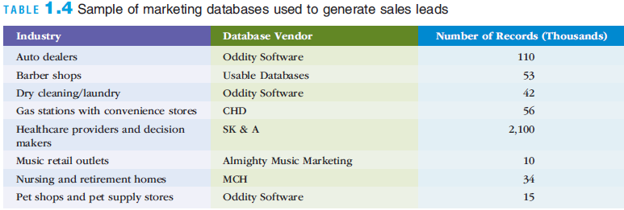
Database Systems and Big Data
Notes:
Database Systems and Big Data

Slide 22
Database Systems and Big Data
Extract-transform-lead (ETL) process
Raw data is extracted from various sources, transformed into a format that will support analysis, and then loaded into the data warehouse
Big data
A term used to describe data collections that are so enormous that traditional data management software, hardware, and analysis processes are incapable of dealing with them
Notes:
Database Systems and Big Data
Extract-transform-lead (ETL) process
Raw data is extracted from various sources, transformed into a format that will support analysis, and then loaded into the data warehouse
Big data
A term used to describe data collections that are so enormous that traditional data management software, hardware, and analysis processes are incapable of dealing with them

Slide 23
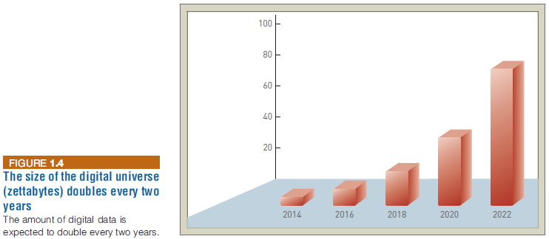
Database Systems and Big Data
Notes:
Database Systems and Big Data

Slide 24
Networks and Cloud Computing
Networks
Connect computers and equipment in a room, building, campus, city, or globally to enable electronic communication
Internet
World’s largest computer network
Public cloud computing
A service provider organization owns and manages the hardware, software, networking, and storage devices in order to provide shared resources to users via the Internet
Notes:
Networks and Cloud Computing
Networks
Connect computers and equipment in a room, building, campus, city, or globally to enable electronic communication
Internet
World’s largest computer network
Public cloud computing
A service provider organization owns and manages the hardware, software, networking, and storage devices in order to provide shared resources to users via the Internet

Slide 25
Networks and Cloud Computing
Intranet
Enable communication, collaboration, search functions, and information sharing between member of an organization using a Web browser
Extranet
A network based on Web technologies that allows selected outsiders to access authorized resources of a company’s intranet
Notes:
Networks and Cloud Computing
Intranet
Enable communication, collaboration, search functions, and information sharing between member of an organization using a Web browser
Extranet
A network based on Web technologies that allows selected outsiders to access authorized resources of a company’s intranet

Slide 26
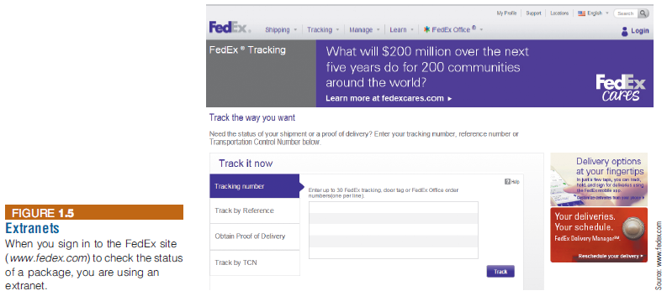
Networks and Cloud Computing
Notes:
Networks and Cloud Computing

Slide 27
Networks and Cloud Computing
Internet of Things (IoT)
A network of physical objects embedded with sensors, processors, software, and network connectivity capability to enable them to exchange data with the manufacturer of the device, device operators, and other connected devices
Internet of Everything (IoE)
Encompasses not only machine-to-machine but also people-to-people and people-to-machine connections
Notes:
Networks and Cloud Computing
Internet of Things (IoT)
A network of physical objects embedded with sensors, processors, software, and network connectivity capability to enable them to exchange data with the manufacturer of the device, device operators, and other connected devices
Internet of Everything (IoE)
Encompasses not only machine-to-machine but also people-to-people and people-to-machine connections

Slide 28
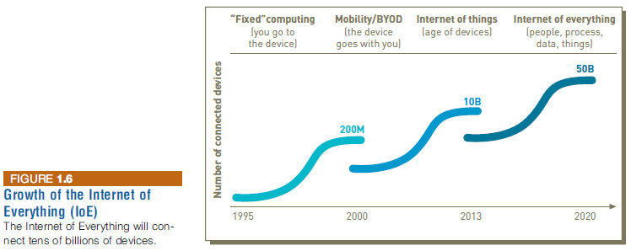
Networks and Cloud Computing
Notes:
Networks and Cloud Computing

Slide 29
Business Information Systems
Information systems are used in all functional areas of business organizations, such as:
Accounting and finance
Customer service
Human resources
Manufacturing
Research and development
Sales and marketing
Notes:
Business Information Systems
Information systems are used in all functional areas of business organizations, such as:
Accounting and finance
Customer service
Human resources
Manufacturing
Research and development
Sales and marketing

Slide 30
Business Information Systems
Information systems are also used in nearly every industry, such as:
Agriculture
Finance
Health care
Mining
Professional services
Retail
Notes:
Business Information Systems
Information systems are also used in nearly every industry, such as:
Agriculture
Finance
Health care
Mining
Professional services
Retail

Slide 31
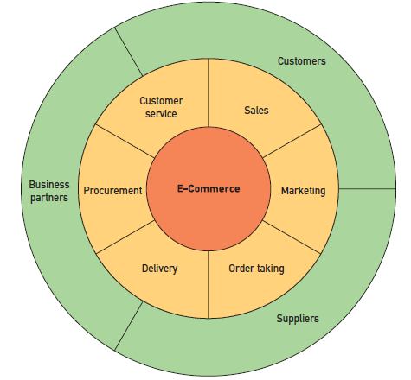

Electronic and Mobile Commerce
E-commerce involves the exchange of money for goods and services over electronic networks
Notes:
Electronic and Mobile Commerce
E-commerce involves the exchange of money for goods and services over electronic networks

Slide 32
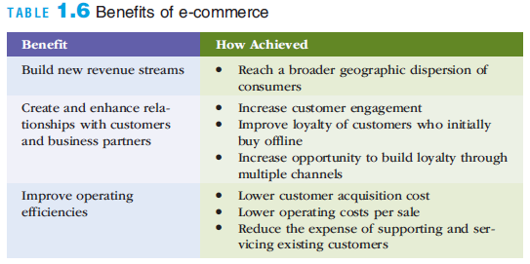
Electronic and Mobile Commerce
Notes:
Electronic and Mobile Commerce

Slide 33
Electronic and Mobile Commerce
Mobile commerce (m-commerce): the use of mobile, wireless devices to place orders and conduct business
Used to support all forms of e-commerce:
Business-to-business (B2B)
Business-to-consumer (B2C)
Consumer-to-consumer (C2C)
Government-to-citizen (G2C)
E-business: use of information systems and the Internet to perform business-related tasks and functions
Notes:
Electronic and Mobile Commerce
Mobile commerce (m-commerce): the use of mobile, wireless devices to place orders and conduct business
Used to support all forms of e-commerce:
Business-to-business (B2B)
Business-to-consumer (B2C)
Consumer-to-consumer (C2C)
Government-to-citizen (G2C)
E-business: use of information systems and the Internet to perform business-related tasks and functions

Slide 34
Enterprise Systems
Transaction
Any business-related exchange, such as payments to employees and suppliers and sales to customers
Transaction processing system (TPS)
An organized collection of people, procedures, software, databases, and devices
Used to perform and record completed business transactions
Management information system (MIS)
Organized collection of people, procedures, software, databases, and devices
Provides routine information to managers and decision makers
Focuses on operational efficiency
Provides standard reports generated with data and information from the TPS or ERP
Notes:
Enterprise Systems
Transaction
Any business-related exchange, such as payments to employees and suppliers and sales to customers
Transaction processing system (TPS)
An organized collection of people, procedures, software, databases, and devices
Used to perform and record completed business transactions
Management information system (MIS)
Organized collection of people, procedures, software, databases, and devices
Provides routine information to managers and decision makers
Focuses on operational efficiency
Provides standard reports generated with data and information from the TPS or ERP

Slide 35
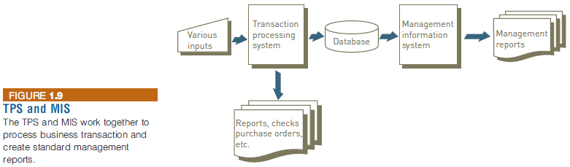
Enterprise Systems
Notes:
Enterprise Systems

Slide 36
Enterprise Systems
Enterprise resource planning (ERP)
A set of integrated programs
Manages the vital business operations for an entire multisite, global organization
Most ERP systems provide integrated software to support manufacturing and finance
Also provide support for business analytics and e-business
Notes:
Enterprise Systems
Enterprise resource planning (ERP)
A set of integrated programs
Manages the vital business operations for an entire multisite, global organization
Most ERP systems provide integrated software to support manufacturing and finance
Also provide support for business analytics and e-business

Slide 37
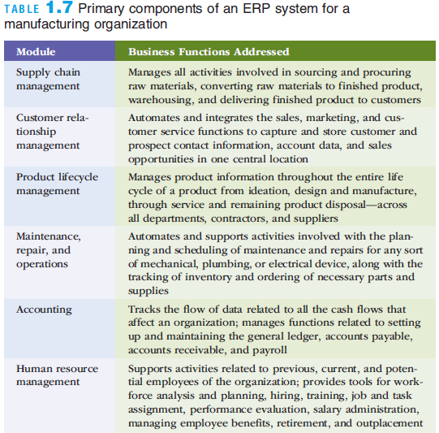
Enterprise Systems
Notes:
Enterprise Systems

Slide 38
Enterprise Systems
ERP system benefits:
Provide a global view of operational/planning data
Lower the cost of doing business
Ensure compliance
Automate core business operations
Improve customer service
Reduce time to market by sharing evolving product data
Notes:
Enterprise Systems
ERP system benefits:
Provide a global view of operational/planning data
Lower the cost of doing business
Ensure compliance
Automate core business operations
Improve customer service
Reduce time to market by sharing evolving product data

Slide 39
Business Intelligence and Analytics
Business intelligence (BI)
Includes a wide range of applications, practices, and technologies for the extraction, transformation, integration, visualization, analysis, interpretation, and presentation of data to support improved decision making
Business analytics
The extensive use of data and quantitative analysis to support fact-based decision making within organizations
Notes:
Business Intelligence and Analytics
Business intelligence (BI)
Includes a wide range of applications, practices, and technologies for the extraction, transformation, integration, visualization, analysis, interpretation, and presentation of data to support improved decision making
Business analytics
The extensive use of data and quantitative analysis to support fact-based decision making within organizations

Slide 40
Knowledge Management and Specialized Information Systems
Knowledge management systems (KMSs)
An organized collection of people, procedures, software, databases, and devices that:
Stores and retrieves knowledge
Improves collaboration
Locates knowledge sources
Captures and uses knowledge
Enhances the knowledge management process
Notes:
Knowledge Management and Specialized Information Systems
Knowledge management systems (KMSs)
An organized collection of people, procedures, software, databases, and devices that:
Stores and retrieves knowledge
Improves collaboration
Locates knowledge sources
Captures and uses knowledge
Enhances the knowledge management process

Slide 41
Planning, Acquiring, and Building Systems
Project
A temporary endeavor undertaken to create a unique product, service, or result
Attempts to achieve specific business objectives and is subject to certain constraints
They way much of an organization’s work gets done
Notes:
Planning, Acquiring, and Building Systems
Project
A temporary endeavor undertaken to create a unique product, service, or result
Attempts to achieve specific business objectives and is subject to certain constraints
They way much of an organization’s work gets done

Slide 42
Strategic Planning and Project Management
Strategic planning
Used to improve alignment between the needs of the business and the activities of the information systems organization
Alignment means that the IS organization and its resources are focused on efforts that support the key objectives defined in the strategic plan of business
Notes:
Strategic Planning and Project Management
Strategic planning
Used to improve alignment between the needs of the business and the activities of the information systems organization
Alignment means that the IS organization and its resources are focused on efforts that support the key objectives defined in the strategic plan of business

Slide 43
System Acquisition and Development
System acquisition
Process used to obtain the information system resources needed to provide the services necessary to meet a specific set of needs
System development
The activity of building information systems to meet users’ needs
Projects can range from small to very large
Notes:
System Acquisition and Development
System acquisition
Process used to obtain the information system resources needed to provide the services necessary to meet a specific set of needs
System development
The activity of building information systems to meet users’ needs
Projects can range from small to very large

Slide 44
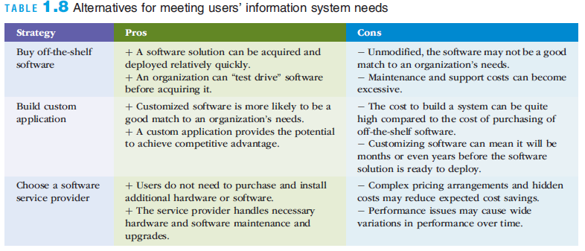
System Acquisition and Development
Notes:
System Acquisition and Development

Slide 45
Information Systems in Business and Society
The speed and widespread use of information systems
Opens users to a variety of threats from unethical people
Computer-related attacks can come from individuals, groups, companies, and countries
Notes:
Information Systems in Business and Society
The speed and widespread use of information systems
Opens users to a variety of threats from unethical people
Computer-related attacks can come from individuals, groups, companies, and countries

Slide 46
Cybercrime and Information System Security
Cybercriminals
Motivated by the potential for monetary gain
Hack into computers systems to steal
Cyberterrorism
The intimidation of a government or a civilian population by using information technology to disable critical national infrastructure
To achieve political, religious, or ideological goals
Notes:
Cybercrime and Information System Security
Cybercriminals
Motivated by the potential for monetary gain
Hack into computers systems to steal
Cyberterrorism
The intimidation of a government or a civilian population by using information technology to disable critical national infrastructure
To achieve political, religious, or ideological goals

Slide 47
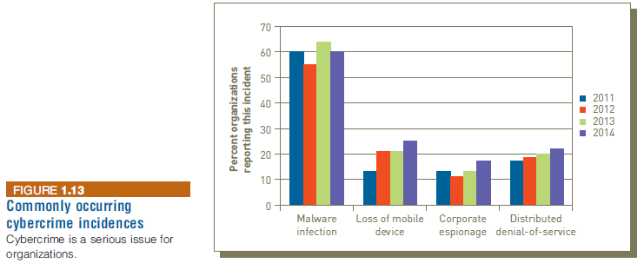
Cybercrime and Information System Security
Notes:
Cybercrime and Information System Security

Slide 48
Ethical, Legal, and Social Issues of Information Systems
Ethics
A set of beliefs about right and wrong behavior
Ethical behavior
Conforms to generally accepted social norms
The use of information about people
Requires balancing the needs of those who want to use the information against the rights and desires of the people whose information may be used
Notes:
Ethical, Legal, and Social Issues of Information Systems
Ethics
A set of beliefs about right and wrong behavior
Ethical behavior
Conforms to generally accepted social norms
The use of information about people
Requires balancing the needs of those who want to use the information against the rights and desires of the people whose information may be used

Slide 49
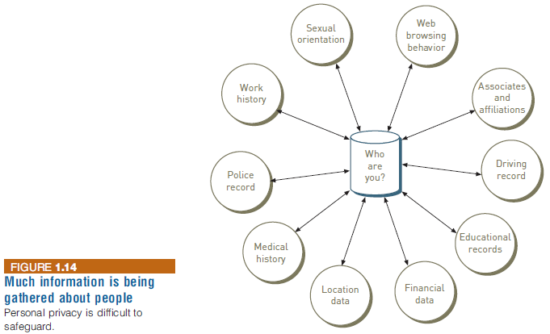
Ethical, Legal, and Social Issues of Information Systems
Notes:
Ethical, Legal, and Social Issues of Information Systems

Slide 50
Ethical, Legal, and Social Issues of Information Systems
Internet censorship
The control or suppression of the publishing or accessing of information on the Internet
Digital divide
A term used to describe the gulf between those who do and those who don’t have access to modern information and communications technology
Net neutrality
The principle that Internet service providers (ISPs) should be required to treat all Internet traffic running over their networks the same
Notes:
Ethical, Legal, and Social Issues of Information Systems
Internet censorship
The control or suppression of the publishing or accessing of information on the Internet
Digital divide
A term used to describe the gulf between those who do and those who don’t have access to modern information and communications technology
Net neutrality
The principle that Internet service providers (ISPs) should be required to treat all Internet traffic running over their networks the same

Slide 51
Summary
The value of information is directly linked to how it helps decision makers achieve the organization’s goals
Information systems are composed of fundamental components that must be carefully assembled and integrated to work well together
Managers have an essential role to play in the successful implementation and use of information systems-that role changes depending on which type of IS system is being implemented
Notes:
Summary
The value of information is directly linked to how it helps decision makers achieve the organization’s goals
Information systems are composed of fundamental components that must be carefully assembled and integrated to work well together
Managers have an essential role to play in the successful implementation and use of information systems-that role changes depending on which type of IS system is being implemented

Slide 52
Summary
An organization’s infrastructure technology forms the foundation upon which its systems and applications are built
Organizations employ a variety of information systems to improve the way they conduct business and make fact-based decisions
Strategic planning and project management are keys to ensuring that the organization is working effectively on the right projects
Information systems must be applied thoughtfully and carefully so that society, organizations, and individuals around the globe can reap their enormous benefits
Notes:
Summary
An organization’s infrastructure technology forms the foundation upon which its systems and applications are built
Organizations employ a variety of information systems to improve the way they conduct business and make fact-based decisions
Strategic planning and project management are keys to ensuring that the organization is working effectively on the right projects
Information systems must be applied thoughtfully and carefully so that society, organizations, and individuals around the globe can reap their enormous benefits

